Slide 1
CS499 Fade
By Yuyang Feng, Ruoyu Ma, and Mamuerbieke Jieensi

Slide 2
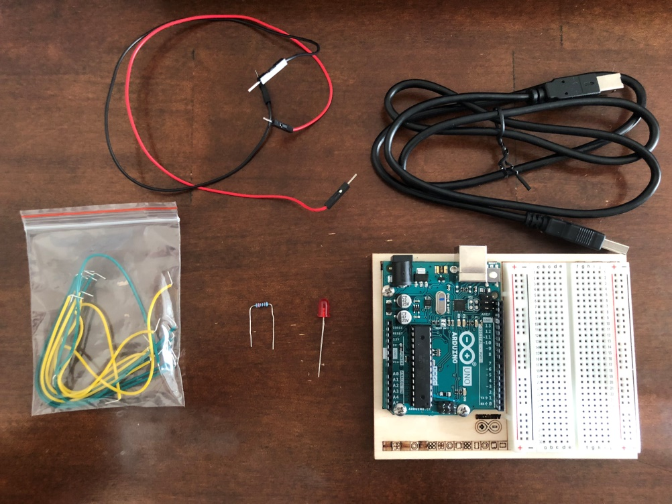
Components
Red LED
Color Resistor
(5 bands: red red black black brown)
Wires
Breadboard
Arduino Platform

Slide 3
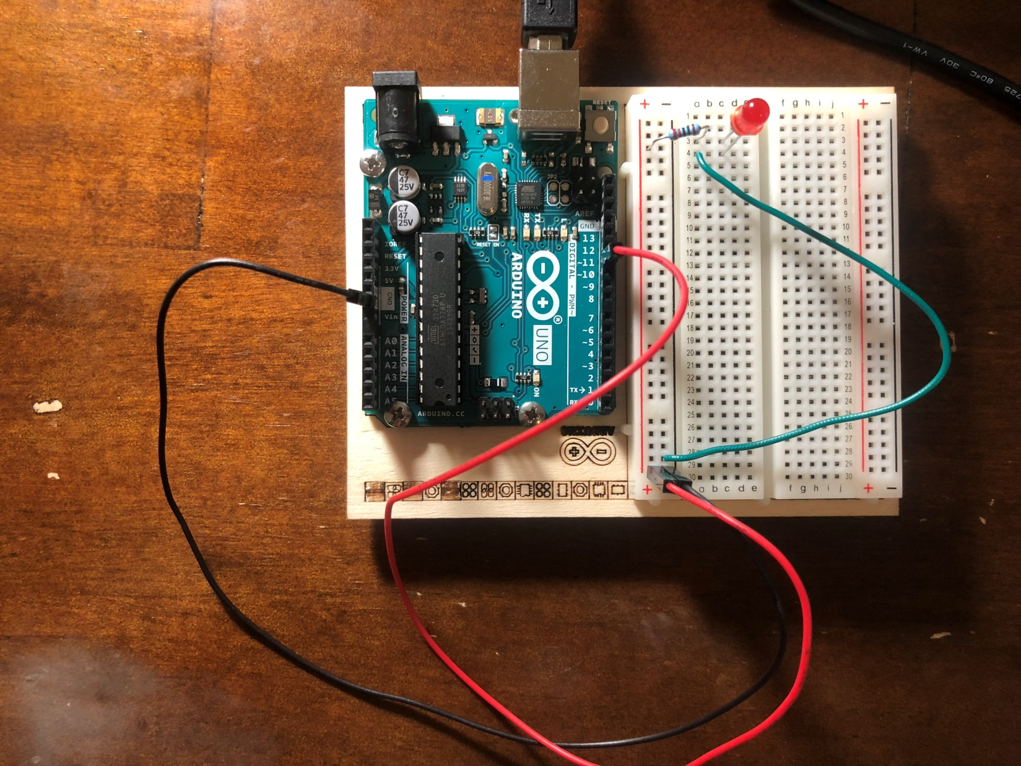
Circuit

Slide 4
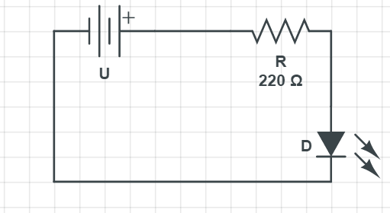
Schematic

Slide 5
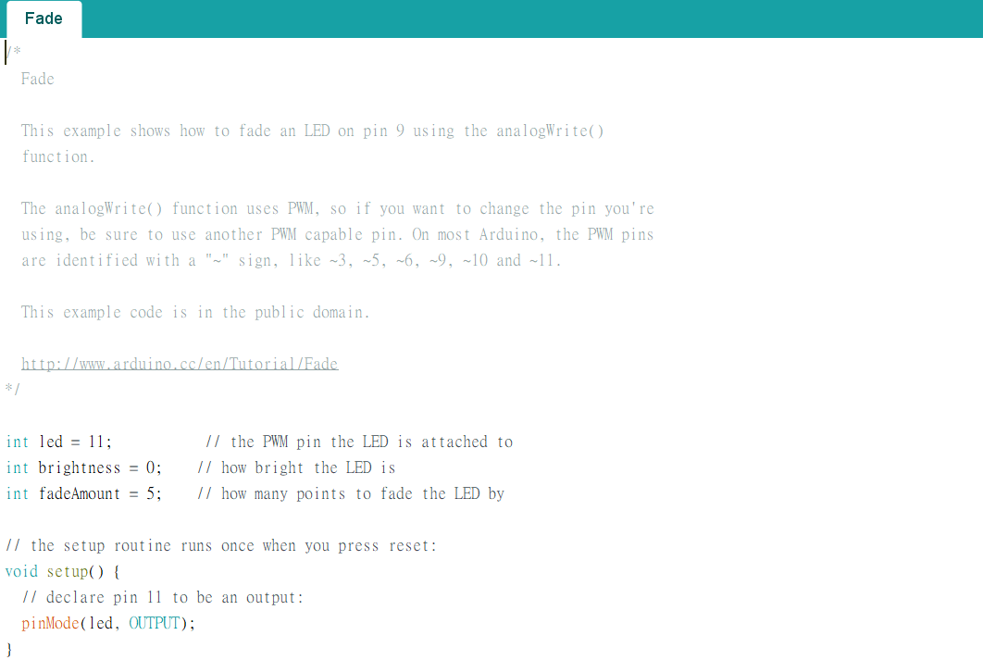
Code

Slide 6
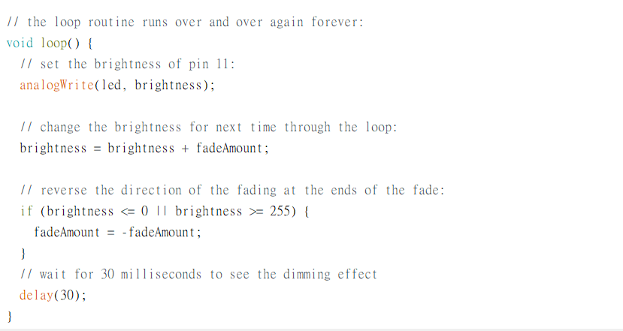
Code(cont.)

Slide 7
Question?

